Slide 1



Growing up Online
Rethinking Screen Time Guidelines for a Connected Singapore
Statistical Thinking for Data Science
Goh Yun Si
Zexel Nicholas Lew
Li Du
Gabriel Manuel Sidik
Xiong Yu
Notes:
Hi everyone, first of all, I do apologize for not being able to join in person today. But hey let’s acknowledge the irony in which our project is focused on screen time, to which if not for recent developments I would probably not have been able to present like this today. We are truly in the age where we are growing up online together, and our team hopes that this would be a good time for all of us to reflect a little about the time we spend on screens and how it has been impacting our lives.

Slide 2
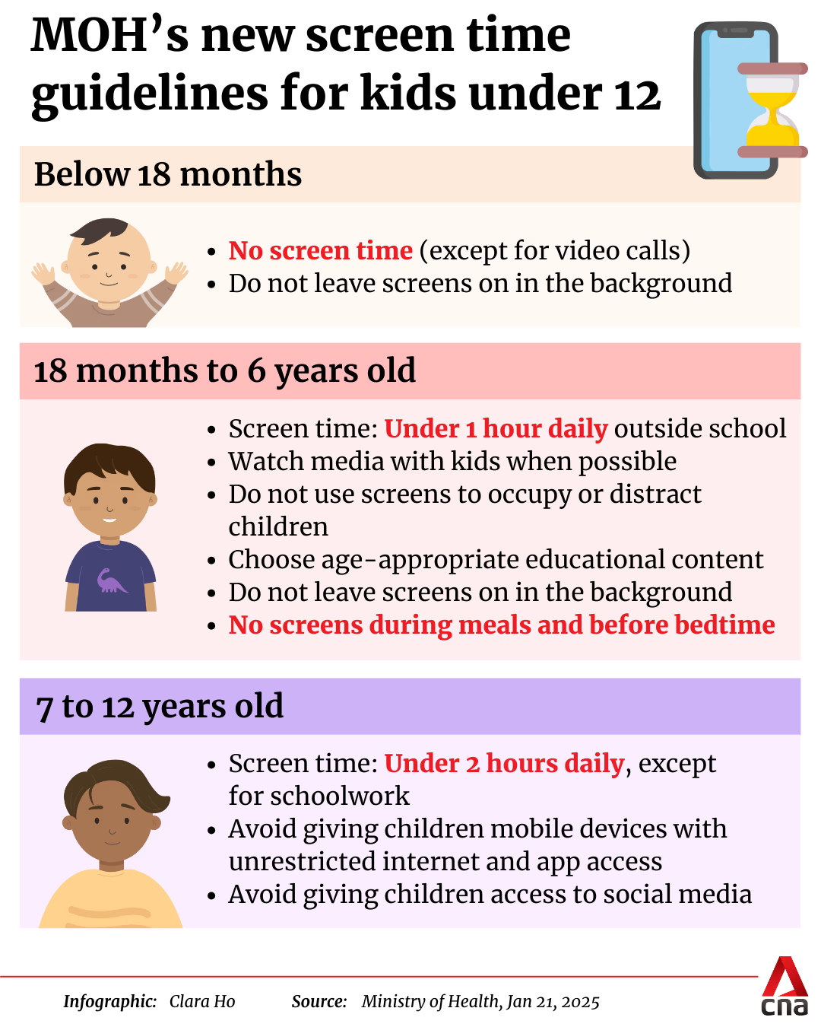



Overall Concept
Should Singapore’s guidelines on screen time for children be extended to youth and adults?
0-11
year old children
12-17
year old youths
18+
year old adults
Notes:
We were inspired by this CNA article earlier this year, in which MOH set out some guidelines for screen time for children. Notably, you can see that MOH set out some numerical guidelines, such as 1 hour or 2 hour limits, for children as they grow up. Today, we want to answer the question, should these guidelines on screen time be extended to youth and adults?

Slide 3
Data Sources
Variety of datasets across different years and sources
Notable characteristics
0-11
year old children
Wong
2020
Kumar
2025
Educational vs Recreational screen time
12-17
year old youths
YRBS
2017, 2019, 2021
Wong
2020
NHANES
2021, 2023
Ordinal Data
18+
year old adults
Soundankar 2019-2024
GSS
2024
Self-Reported surveys
Notes:
To answer this question, we used a variety of datasets across different years and sources, including national surveys and Kaggle datasets. This is so we can get representation across the different age groups, and across different years as well.
As we worked on the problem over the last few weeks, we realised there are some interesting characteristics of the data, and we would like to highlight them here as a prelude to some of the techniques which we will later describe. First it would be to recognise that a distinction should be made between educational and recreational screen time, since 1 is more beneficial than the other. Also, we dealt with a lot of ordinal data, to which the techniques are not really covered in class. Next, there were several self-reported surveys which could introduce some bias.
With that being said, I’ll pass on to Yun Si who will take us through the reality and urgency of addressing this problem.

Slide 4
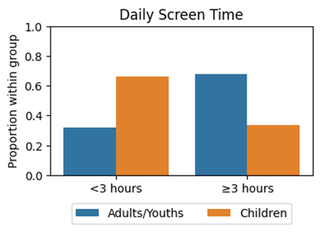
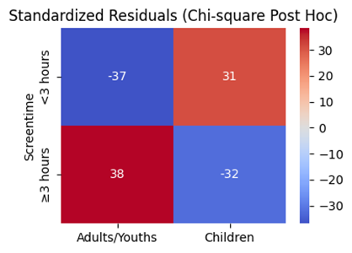
Who’s really glued to the screen?
While policies usually focus on children, a look at U.S. data reveals that
adults and youths spend more time on screens than children.
16363
12001
5614
8358
H₀: Adults/youths screen time is the same as children screen time in US.
H₁: Adults/youths screen time is the different from children screen time in US.
A Chi-square test shows a statistically significant difference (p-value = 0.0000 < 0.05) in screen time between adults/youths & children. A post-hoc standardized residuals test confirms that adults/youths spend more time on screens.
Notes:
As Zexel has mentioned, screen time policies mostly target children, be it the one rolled out by MOH, the strict regulations imposed in China, or the parental control apps in play store. But are children the only ones at risk? We performed a chi-square test on U.S. data and the p-value of 0 indicates that the screen time of adults / youths are different from children’s. The post-hoc standardized residual test on the right here shows that the number of adults/youths spending more than 3 hours on screens daily is higher than expected. So, while we're worried about the kids, we should probably be worried about ourselves too.

Slide 5
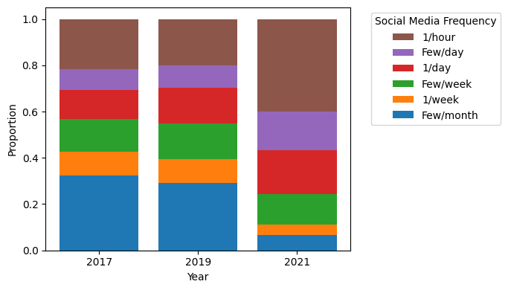
Is the digital surge a recent trend?
U.S. youth social media use was already on the rise, but the pandemic triggered a massive acceleration between 2019 and 2021.
Covid-19 Pandemic
H₀: Screen time in 2017/2019 ≥ 2019/2021.
H₁: Screen time in 2017/2019 < 2019/2021.
Mann-Whitney U-test is a non-parametric method that tests on rank rather than absolute values. It is suitable for ordinal data or when T-test assumptions are not met. However, it has less statistical power than T-test.
A Mann-Whitney U-test showed an increase in youth social media usage from 2017 to 2019 (p-value = 0.0042 < 0.05), and a significant surge in from 2019 to 2021 (p-value = 0.0000 < 0.05).
AI Boom
Notes:
And it seems like the screen time problem is not just a recent trend. Here, we compare U.S. youth social media usage in 2017, 2019, and 2021. As our data are ordinal categories, we used a Mann-Whitney U-test, which is a non-parametric equivalent of T-test that tests on ranks rather than absolute values. From resulting p-values and the bar chart, we concluded that screen time has already been going up since 2017, but the pandemic triggered a massive acceleration between 2019 and 2021. And with the AI boom in the late 2019s, we expect these trends to continue accelerating if nothing was done.

Slide 6




What negative effects are associated with increased screen time?
Physical Effects
- Eye Strain & Myopia
- Sedentary Behaviour - Obesity, Elevated BP
- Shorter, poorer quality of sleep
Our Focus: Mental Health
→ Cognitive & Psychological Effects
- Risk of Depression and Anxiety
- Diminished attention span
- Lower academic performance
Behavioural & Social
- Impulsivity & Aggression
- Social Media: Driven comparison, cyber bullying
Why focus on Mental Health?
- Strongest evidence link with screen time in research
- Measurable outcomes using validated scales (e.g. PHQ-9, WHO-5)
- Local relevance: Rising youth anxiety & depression post-pandemic
Family & Social Fabric
- Fewer shared meals / conversations
- Parent–child conflict over device limits
Notes:
So why should we care about all this screen time? I’m sure everyone already knows that too much screen time has an adverse effect on our physical health, behaviours, as well as social relationships. However, today, we will be focusing on something more insidious, mental health. There are strong research links between screen time and mental health. In recent years, mental health has become such a big topic that organizations have come up with validated scales to measure it more accurately. Furthermore, the pandemic has brought mental health struggles of youths in Singapore into the spotlight. Next, Ken will further examine the negative effects of screen time on mental health.

Slide 7
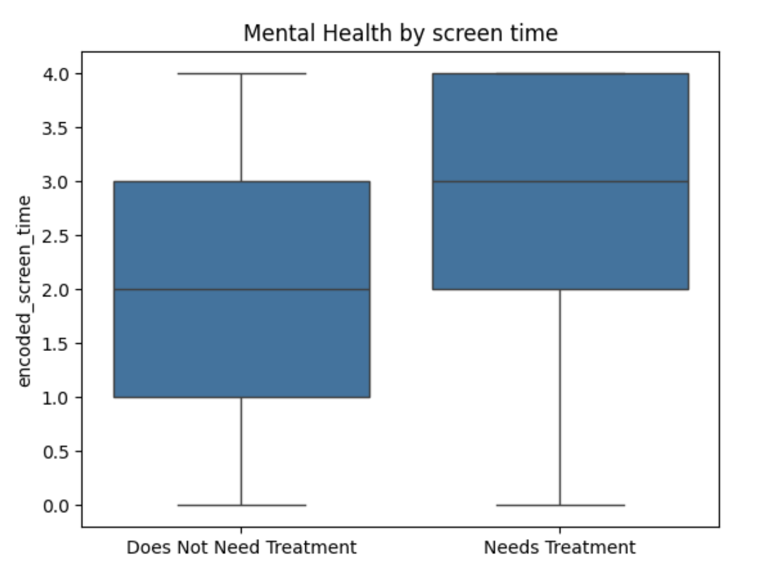

How does screen time affect children?
Children with higher screen usage are more likely to require mental health treatment. This reinforces the importance of existing guidelines for children's screen time.
Screen time | Encoded screen time
Less than 1 hour | 0
1 hour | 1
2 hours | 2
3 hours | 3
4 or more hours | 4
H₀: Children who need mental health treatment and children who don’t have same level of screen time
H₁: Children who need mental health treatment have higher screen time than those who don’t need it
A Mann-Whitney U-test (p-value = 9×10^(-308) <<0.05) showed a extremely large significant difference of screen time between ‘children who need mental health treatment’ vs ‘children who don’t need treatment’.

Slide 8
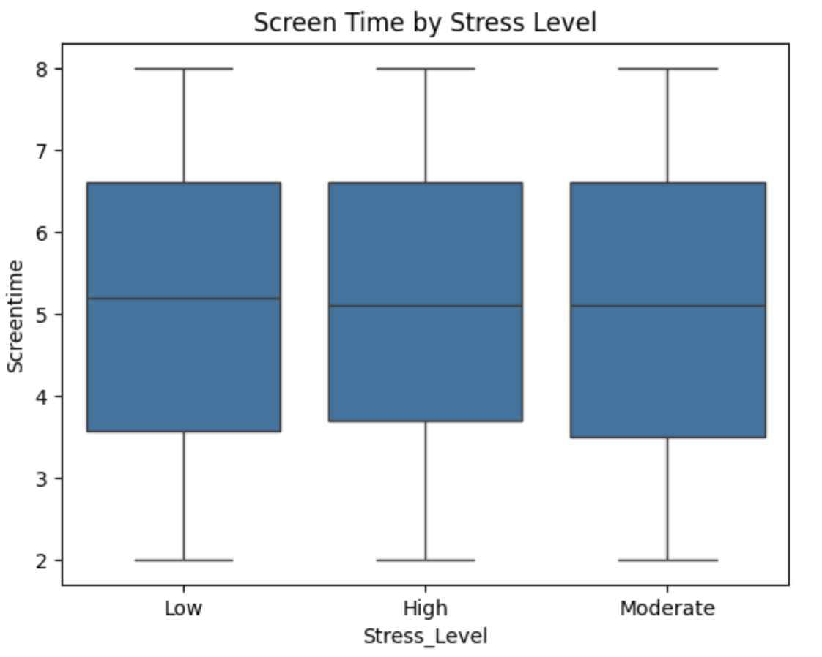
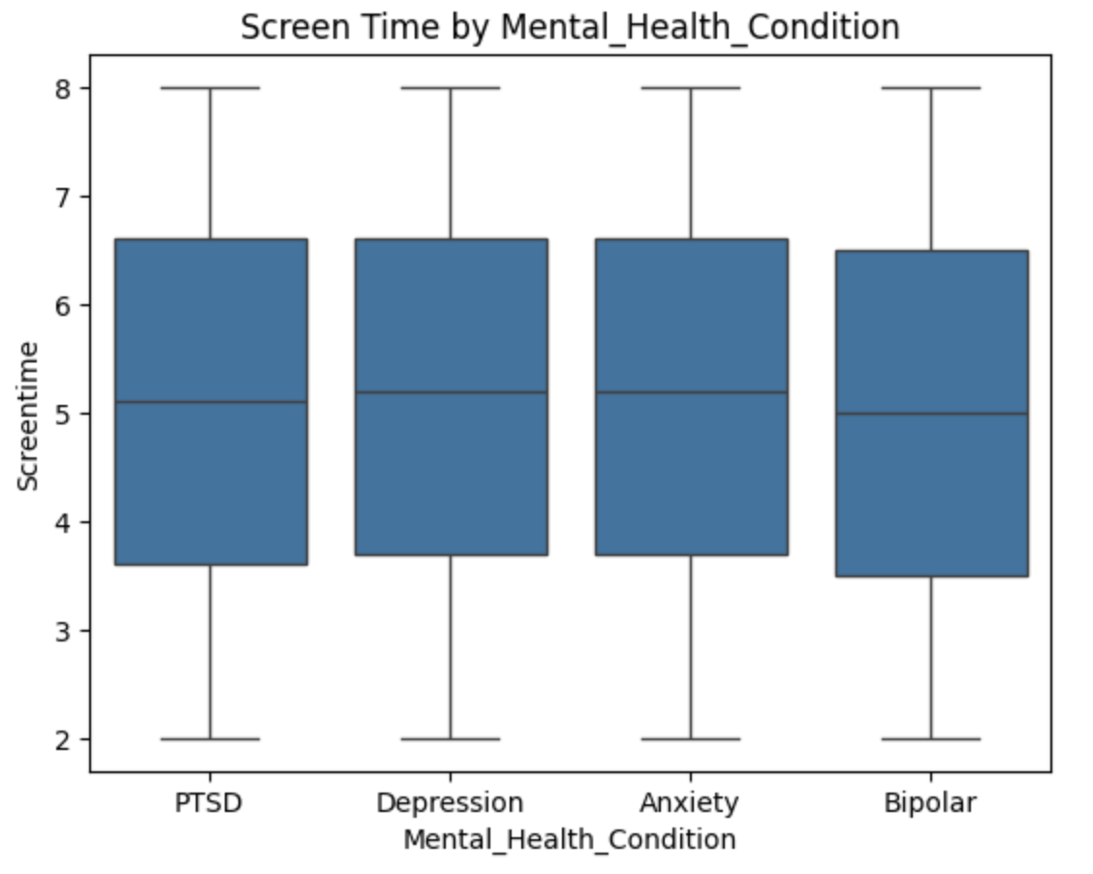
What about adults?
For adults, no direct association were found between screen time and mental health. Adult screen time could be more complex and affected by other factors (e.g work environment, physical health).
Assumptions check
ANOVA key assumption_1:
Equal variance (Levene’s test)
ANOVA key assumption_2:
Normal residuals (Shapiro's test)
Both assumptions violated→
Kruskal Wallis
H₀: Screen time is not significantly different among different groups in both stress level and mental health
H₁: Screen time is significantly different among different groups in both stress level and mental health
Instead of ANOVA, we used Kruskal Wallis H test. The p-value is 0.405 for stress level, and 0.545 for mental health condition. Both are >> 0.05, hence, there is not enough evidence to show the evidence among different groups in mental health condition and stress level.

Slide 9
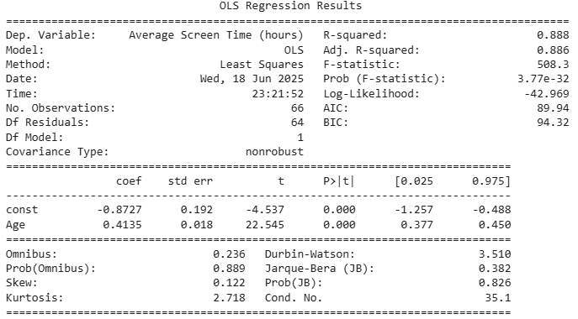
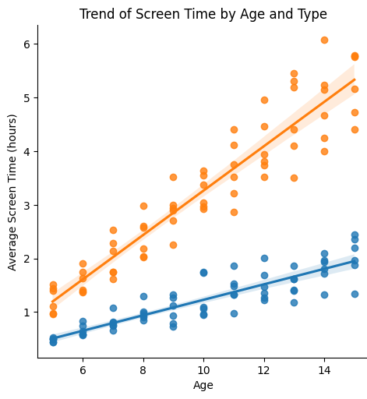
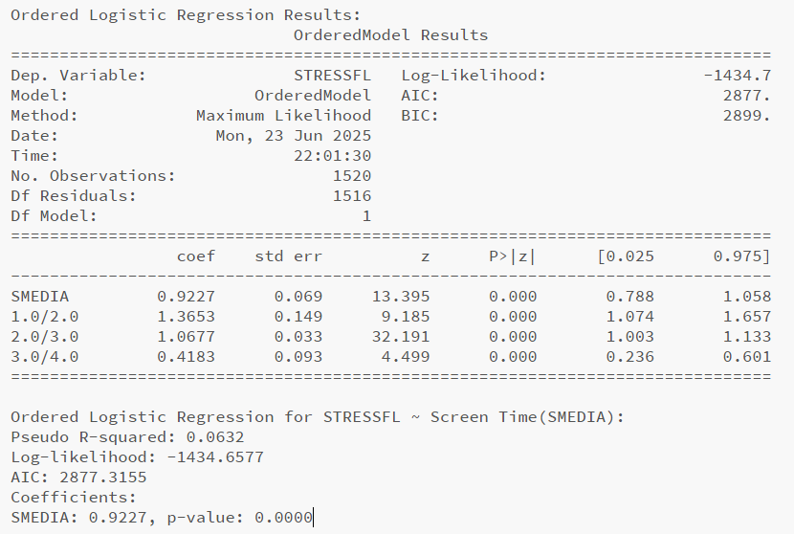
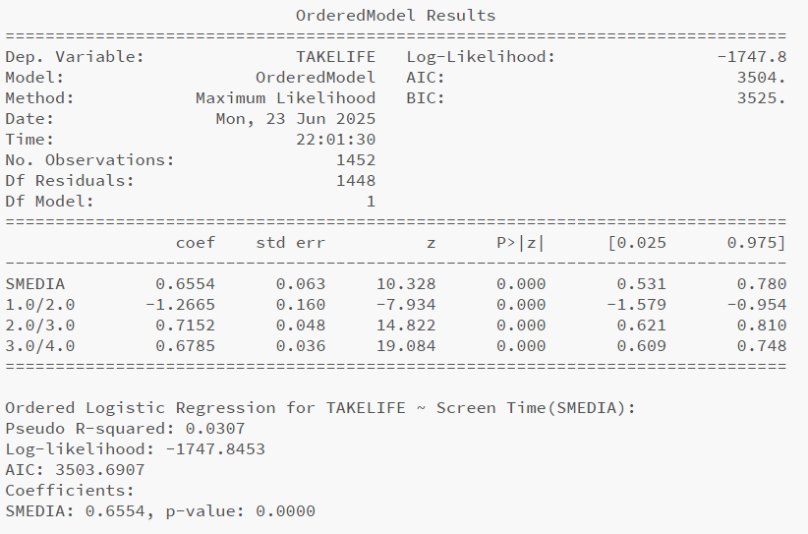

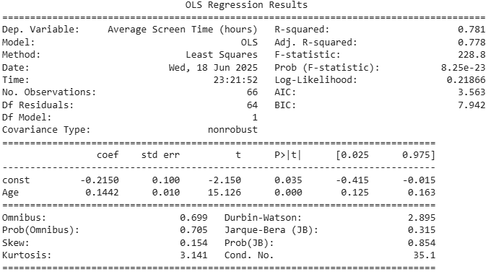
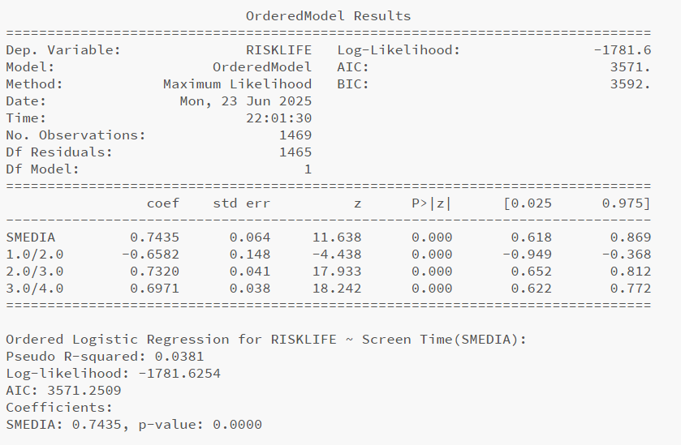



So… Are the existing guidelines justified?
For children, both recreational and educational screen time increase with age. But recreational screen time increases much faster.
Childhood is likely crucial for building healthy habits - so the government policies are proactive rather than reactive.
For adults, daily social media use is linked to stress and reduced mental well-being.
Although feature coefficients are significant (<0.05), the coefficient value is low, and so is the R squared value → The model only explains a small amount of variance.
Given the limited practical ability to regulate adult screen time, policies should prioritize early intervention and general digital well-being. In addition, the lack of explanatory power of this regression suggests that a more holistic approach is required for adults.
Notes:
This slide compares the impact of screen time on children and adults using regression models.
· For children, both recreational and educational screen time increases with age, but recreational screen time grows much faster (as shown in the line chart and OLS(Ordinary Least Squares) regression results with high R-squared value); Meanwhile, a higher coefficient for recreational screen time also prove it(0.4135 vs 0.1442).
· For adults, since these values(STRESSFL, RISKLIFE, and TAKELIFE) are Likert-style scales, we consider them as ordered values, and use ordered regression. Ordered logistic regression reveals that increased social media use is significantly linked to higher stress, risk-taking, and reduced life satisfaction, but the low pseudo R-squared and coefficient values suggest weak explanatory power. A possible reason is that these values are likert-style scales with small values(1-5). However, if we use the Mann-Whitney U test to evaluate, their p-values are significant (e.g., 1.157e-19, one point one five seven times ten to the minus nineteen, is far below 0.001), which indicates that the screen time usage level has a strong association with mental risk behavior or attitudes.
For conclusion：
Childhood is likely crucial for building healthy habits - so the government policies are proactive rather than reactive.
Given the limited practical ability to regulate adult screen time, policies should prioritize early intervention and general digital well-being. In addition, the regression's lack of explanatory power suggests that a more holistic approach is required for adults.

Slide 10
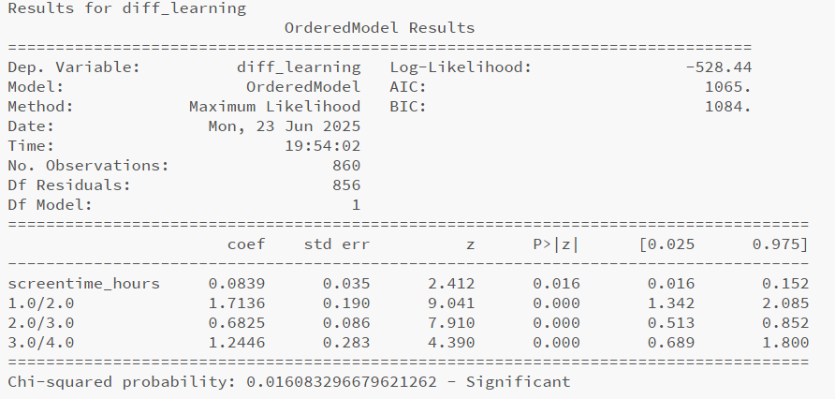
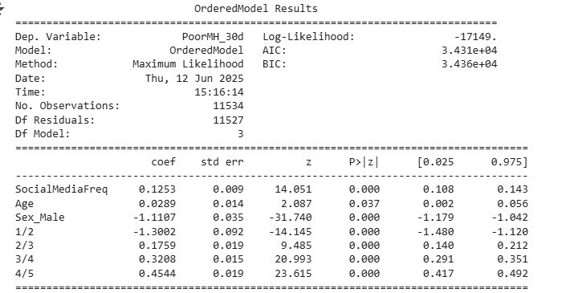
How about Youth? (NHANES 2021/YRBS)
We performed a simple ordinal Logistic Regression on NHANES data across 2021 with screen time as the only explanatory variable this yields inconsistent threshold coefficients despite statistically significant thresholds & coefficients
Using 2021, YRBS (Youth-Risk Behavioral Survey) for our ordinal regression, the coefficient is lower as compared to other attribute - in this case, gender.
Logit Ordinal Regression shows statistically significant correlation between social media frequency and mental health (ordinal variable).
Increasing threshold coefficients are consistent with expected ordinal regression behaviour -> ie coeff(½) < coeff(⅔)
Ordinal Logistic Regression for YRBS
NHANES threshold cut-offs not consistent:
½ - 1.71…
⅔ - 0.68..
¾ - 1.25…
Should be strictly monotonic!
NHANES threshold cut-offs not consistent:
½ - 1.71…
⅔ - 0.68..
¾ - 1.25…
Should be strictly monotonic!
Social media harms mental health of youth, but gender is a stronger differentiator.
For youths, it suggests that addressing screen time is not the only factor we should be targeting.

Slide 11
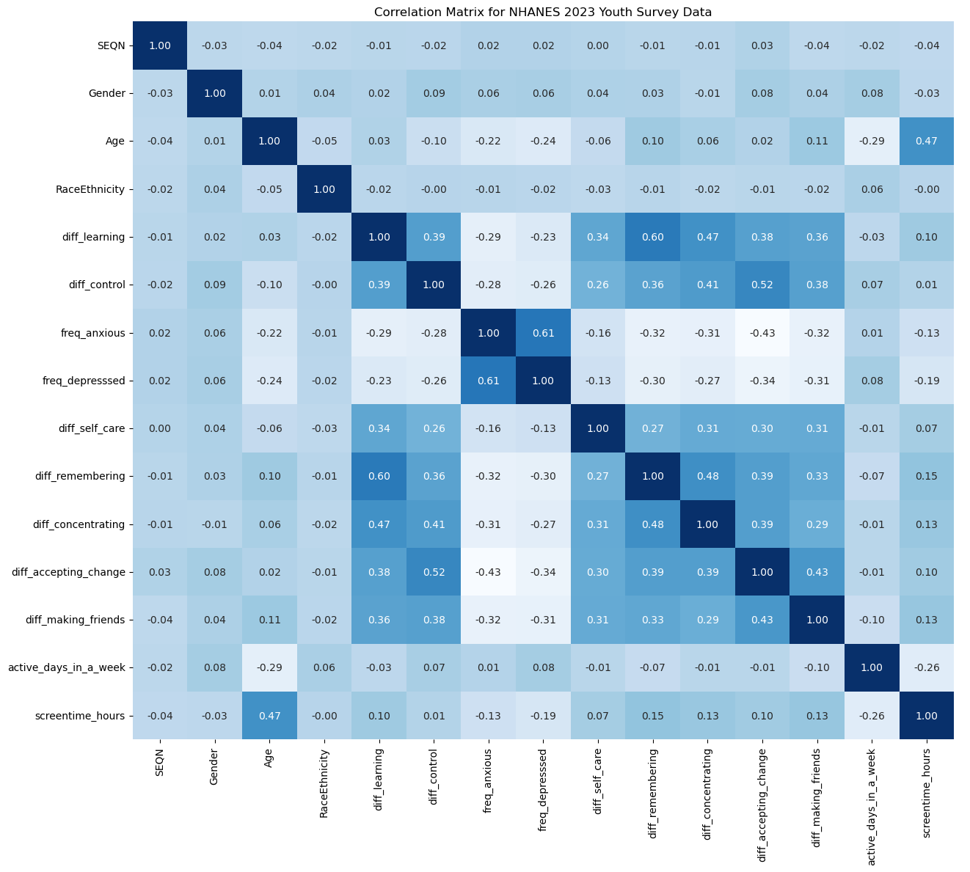
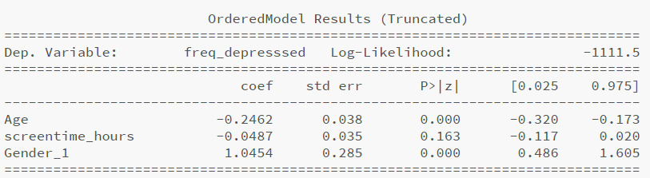
Youth - Analysis of other Explanatory variables
Correlation Plot suggests:
relatively high positive correlations between many of the mental/emotional benchmarks.
Strong negative correlation vs Frequency of Anxiety/Depression
Age has a high correlation with screen time + has a negative correlation with frequency of anxiety/depression
*Full summary results truncated for ease of presentation (other attributes include interaction terms + other terms which have larger p-values than the threshold). Cut-off values have also been removed
Adding “Age” and “Gender” to the regression both decreases the already small coefficient of screentime_hours.
Pseudo R-squared also increases from 0.006 to 0.035
The fact that Pseudo R-squared is still very low suggests that there could be other uncaptured variables which could better explain the frequency of depression

Slide 12
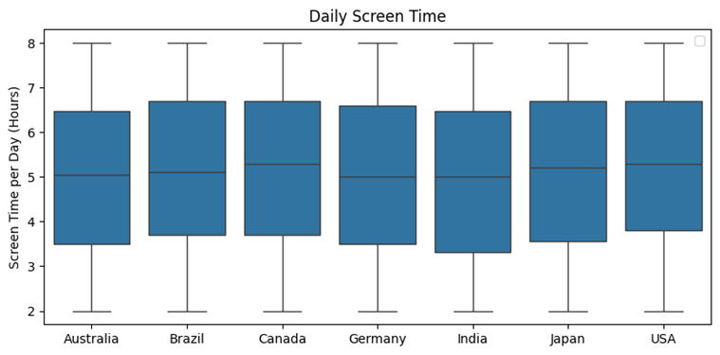
How is this related to Singapore?
Screen time patterns are similar across countries (and possibly Singapore). Although there may be cultural differences, our analysis provides a basis for us to examine Singapore's screen time policies.
Germany
0.2045
Canada
0.8260
India
0.0612
Australia 0.1850
Japan
0.6248
H₀: Adult screen time in US is the same as other countries.
H₁: Adult screen time in US is different from other countries.
Brazil
0.7191
Pairwise T-test was conducted for the adult screen time in U.S. v.s. other countries. The p-value > 0.05 for all countries, suggesting that screen time in U.S. is not that different from other countries.

Slide 13


So… Should Singapore Extend Screen Time Guidelines to Youths & Adults?
Is it time to go beyond kids?
What should we do instead?
Yes, but not as simple as “2 hours max”.
- Youth and adults have autonomy, unlike children.
- Enforcement is tricky, especially across devices/platforms
- One-size-fits-all approach ignores context and purpose of use, e.g.
- work vs. leisure
- learning vs. doom scrolling
Promote Digital Wellbeing
- In Schools: Introduce modules on sleep, attention, and emotional impact of screen time
- In Workplaces: Normalize Disconnection – e.g., screen-free hours
- On Platforms: Built-in usage nudges, screen-time tracking
Promote Integrated Policies and Healthy Lifestyles
- Instead of merely focusing on screen time, a more well rounded approach that targets more aspects of health is more suitable in the long run. Additionally, some effects, such as mental health habits effects, may only be seen in the long term.
Stop Counting Hours, Start Shaping Habits.
Notes:
To finish.

